Slide 1
Dress Code
A company has established a dress code that requires employees to wear what we would call Sunday attire
Draw clothing on the stick figures
Make clear
Sleeve length for men and women
Dress/skirt length for women
Tie length (relative to top of trousers) for men
Notes:
Will use results later

Slide 2
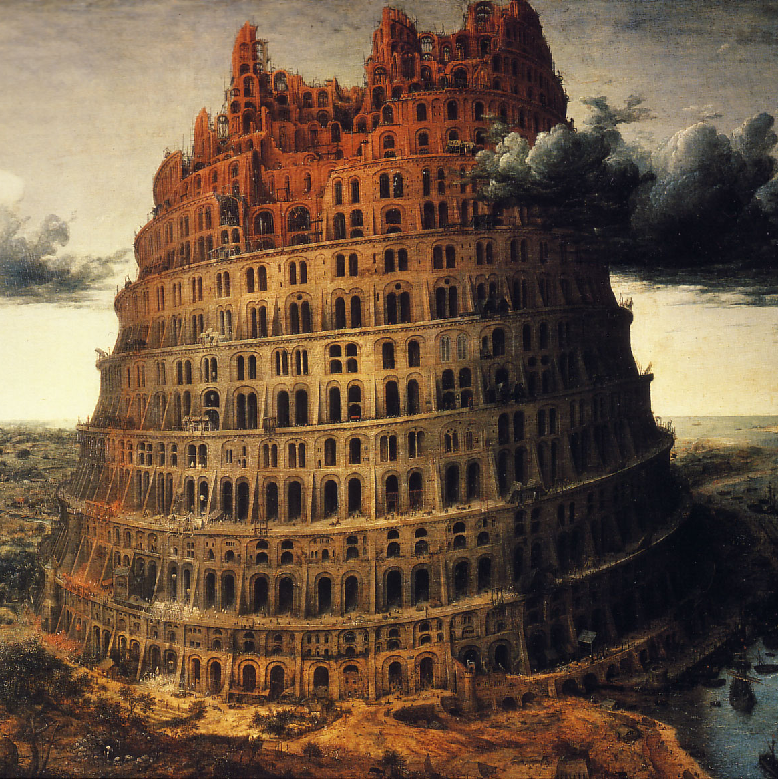
Genesis 11:6-7
And the Lord said, Behold, the people is one, and they have all one language; and this they begin to do: and now nothing will be restrained from them, which they have imagined to do.
Go to, let us go down, and there confound their language, that they may not understand one another’s speech.
Notes:
What does confound mean?
Why was confounding language the action of choice?
Genesis 11:1-9
http://thetowerofbabel.net/

Slide 3
Genesis 11:6-7
And the Lord said, Behold, the people is one, and they have all one language; and this they begin to do: and now nothing will be restrained from them, which they have imagined to do.
Go to, let us go down, and there confound their language, that they may not understand one another’s speech.
Notes:
What does confound mean?
Why was confounding language the action of choice?
Genesis 11:1-9
http://thetowerofbabel.net/

Slide 4
3 Nephi 28:20
And they were cast down into the earth; but they did smite the earth with the word of God, insomuch that by his power they were delivered …
Notes:
Three Nephite disciples

Slide 5
Moses 7:13
And so great was the faith of Enoch that he led the people of God, and their enemies came to battle against them; and he spake the word of the Lord, and the earth trembled, and the mountains fled, even according to his command; and the rivers of water were turned out of their course; and the roar of the lions was heard out of the wilderness; and all nations feared greatly, so powerful was the word of Enoch, and so great was the power of the language which God had given him.

Slide 6
The Power of Language
Notes:
Teach respect for women

Slide 7


Shakespeare
Had Roses
All Wrong
(NPR)
http://fortgreenebk.files.wordpress.com/2008/05/manhattan_bridge.jpg
Notes:
6:50

Slide 8
Loaded Words (NPR)
Gun control
Gun violence prevention
Gun rights
Estate tax
Death tax
Oil drilling
Energy exploration
Pro-choice
Liberal
Progressive
Reform
Notes:
3:46
“Change words and you can change opinion”
Words do more than describe the world. They define it and shape it.

Slide 9
Words Are Tools of Thought
The words we use reinforce current realities
Sexist
Racist
Ageist
We can use words to maintain the status quo
Or to think in new ways
Sherryl Kleinman, “Why Sexists Language Matters”, http://www.alternet.org/story/48856/
Notes:
Racist: 4 Nephi 1:17 “neither were there Lamanites, nor any manner of -ites; but they were in one, the children of Christ, and heirs to the kingdom of God.”
Which went first: divisions among the people (race, ancestry) or the language to describe those divisions?

Slide 10
Freshman, Chairman, You Guys
“In 1986 Douglas Hofstadter, a philosopher, wrote a parody of sexist language by making an analogy with race. His article (‘A Person Paper on Purity in Language’) creates an imaginary world in which generics are based on race rather than gender. In that world, people would use ‘freshwhite,’ ‘chairwhite’ and yes, ‘you whiteys.’ People of color would hear ‘all whites are created equal’ -- and be expected to feel included. Substituting ‘white’ for ‘man’ makes it easy to see why using ‘man’ for all human beings is wrong. Yet, women are expected to feel flattered by ‘freshman,’ ‘chairman’ and ‘you guys.’”
Sherryl Kleinman, “Why Sexists Language Matters”, http://www.alternet.org/story/48856/
Notes:
Person Paper rather than White Paper

Slide 11
Generics
Male-based generics are an indicator – and more importantly, a reinforcer – of a system in which “man” in the abstract and men in the flesh are privileged over women
Sherryl Kleinman, “Why Sexists Language Matters”, http://www.alternet.org/story/48856/
Notes:
Male-based generics: fireman, policeman, mailman, freshman, chairman

Slide 12
Generics
Think of one female-based generic
Try calling
A group of male students “freshwomen”
Your male boss “chairwoman”
Sherryl Kleinman, “Why Sexists Language Matters”, http://www.alternet.org/story/48856/

Slide 13
Generics
“All those ‘man’ words cumulatively reinforce the message that men are the standard and that women should be subsumed by the male category.”
Sherryl Kleinman, “Why Sexists Language Matters”, http://www.alternet.org/story/48856/
Notes:
Consider your drawings: female engineer & male receptionist

Slide 14
Effectiveness
All operations must be basic
Calculated by a man…
Using pencil and paper
In a finite amount of time
Good examples found in GCD
Notes:
Example from a student presentation
My question: What if it was calculated by a woman?

Slide 15
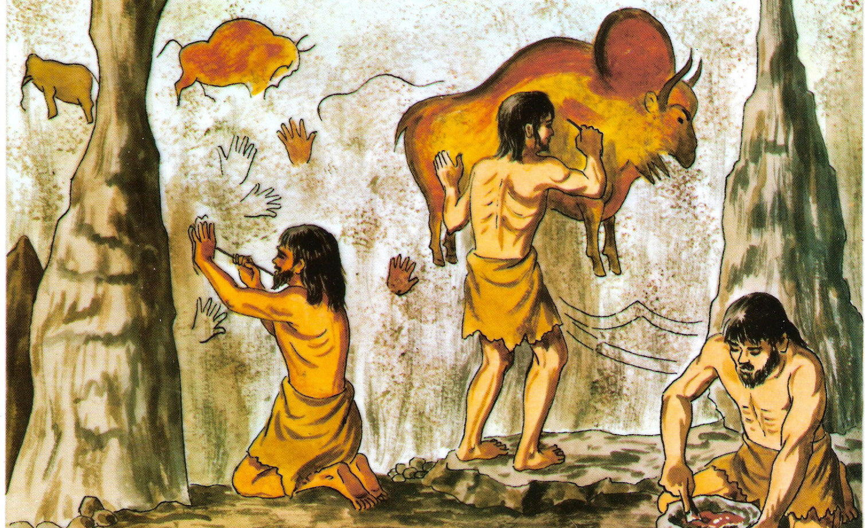
Cave People
“If you ask children to draw ‘cavemen,’ they do draw cave men.”
Kathryn Campbell-Kibler
Ohio State University
Notes:
Here’s where it matters
http://www.sirgy.com/wp-content/uploads/2013/04/cave-man.jpg

Slide 16
Pronouns
Very difficult to adopt gender-neutral pronouns
Attempts in 19th century
Grammatical correctness
More than 100 proposals – none stuck
Attempts in the 1970s
Equality for women
Notes:
Grammatical correctness rather than political correctness

Slide 17
Help is Available
Purdue Online Writing Lab
Stereotypes and Biased Language
Appropriate Pronoun Usage

